Slide 1
SCHOOL MANAGEMENT SYSTEM
A school management system is a data management software for education sector establishments used to manage student data.

Slide 2
GUI Application Framework
There are multiple framework available in java for making GUI applications. Some of them are :-
Spring
AWT
JavaFX
In this project we will be using JavaFX to make GUI.

Slide 3
JavaFX in Java
JavaFX is a set of graphics and media packages that enables developers to design, create, test, debug, and deploy rich client applications that operate consistently across diverse platforms.
Here are some key features and concepts related to JavaFX:
JavaFX provides a rich set of UI controls such as buttons, text fields, tables, lists, etc., which developers can use to create interactive user interfaces.
FXML is an XML-based markup language that allows developers to define user interfaces separately from the application logic. It provides a way to design UIs.
JavaFX supports CSS for styling UI components, providing developers with a flexible way to customize the appearance of their applications.

Slide 4
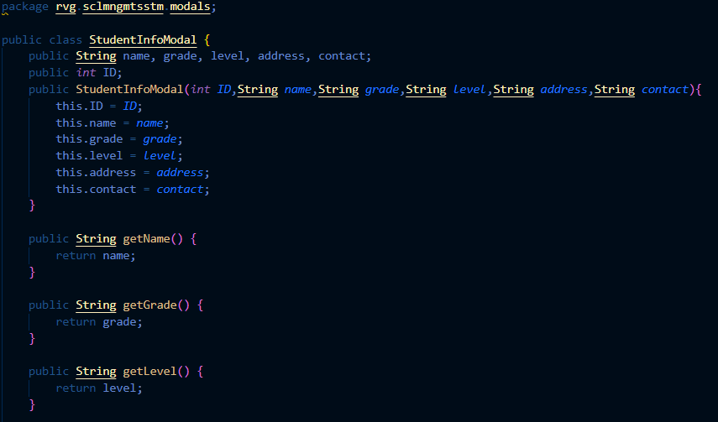
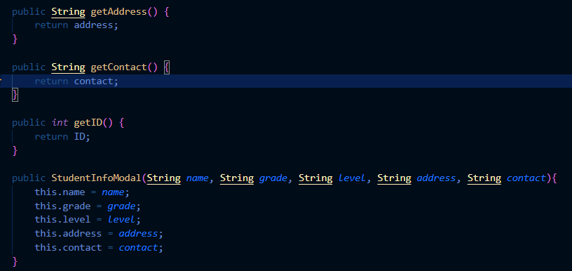
Modal For Data
To store Student, Teacher and Course data in an arranged factor I have created modal classes for every type of data. I will be storing data to files as an object of modals.

Slide 5
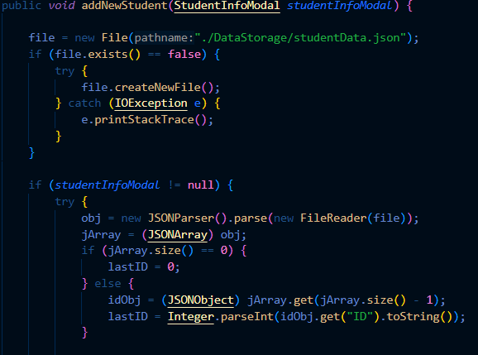
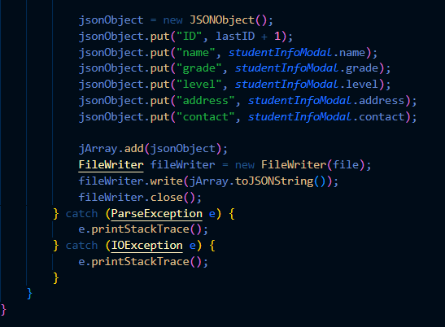
Insert Operation

Slide 6
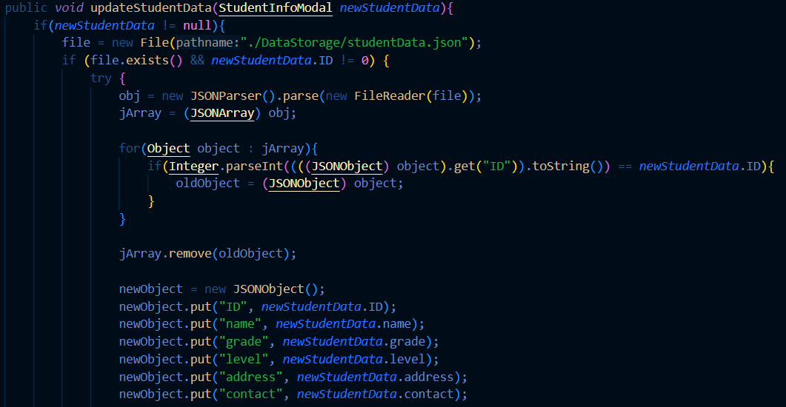
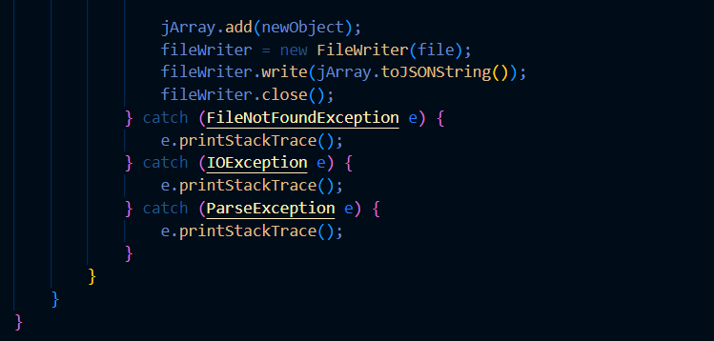
Update Operation

Slide 7
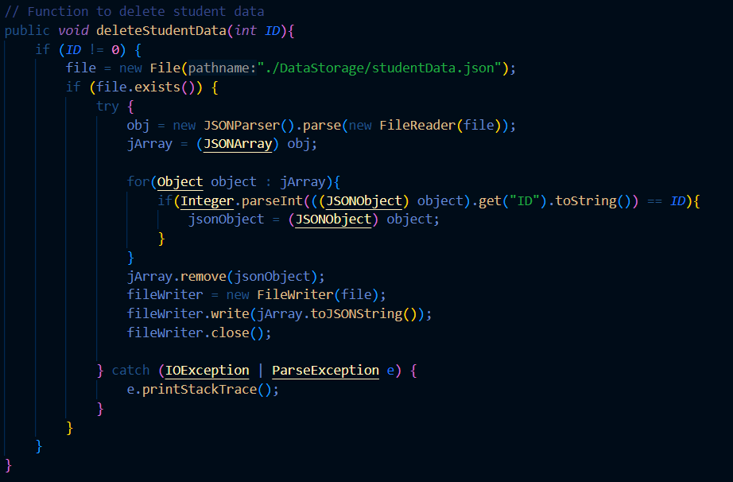
Delete Operation

Slide 8
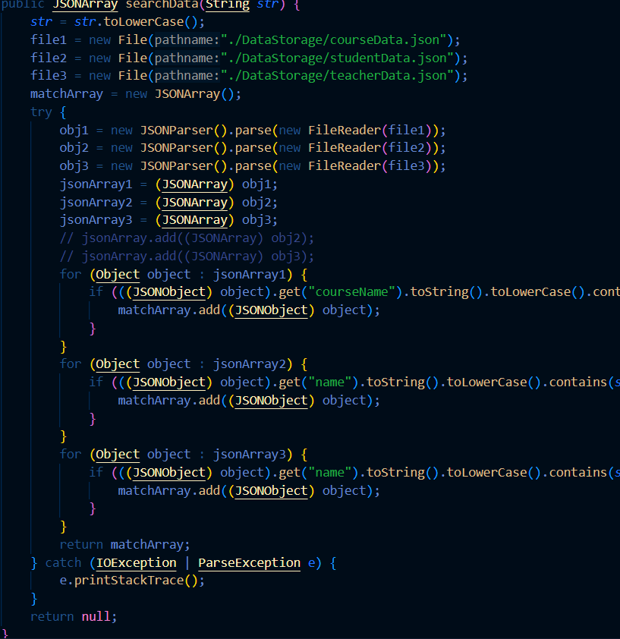
Search Data with Words

Slide 9
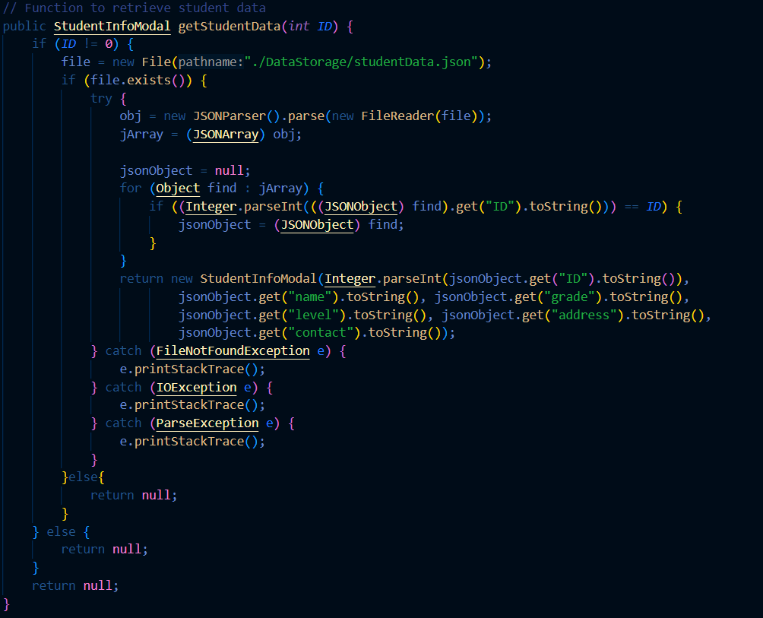
Get data with an unique ID

Slide 10
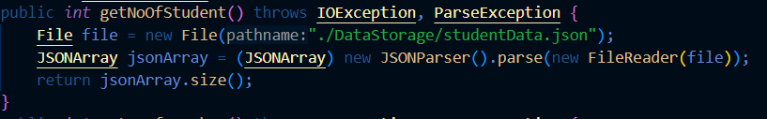
No of Data stored in a Table

Slide 11
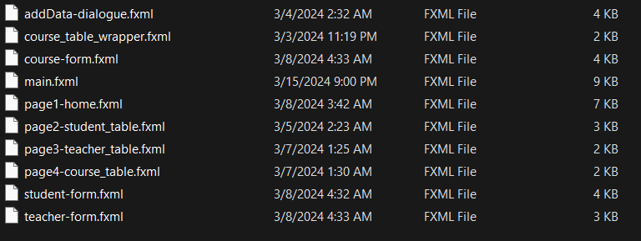
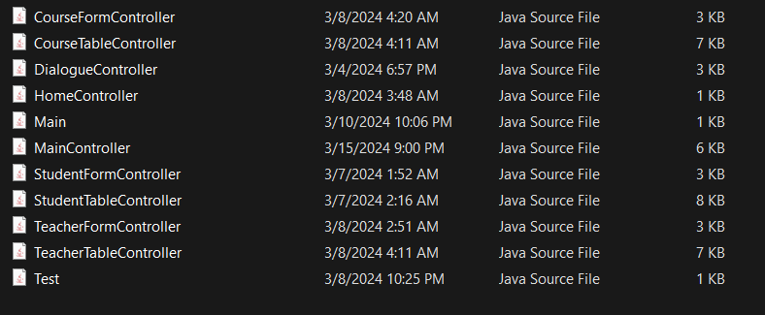
GUI and Controls
Many XML files are created to make GUI and controller classes are created to control GUI.

Slide 12
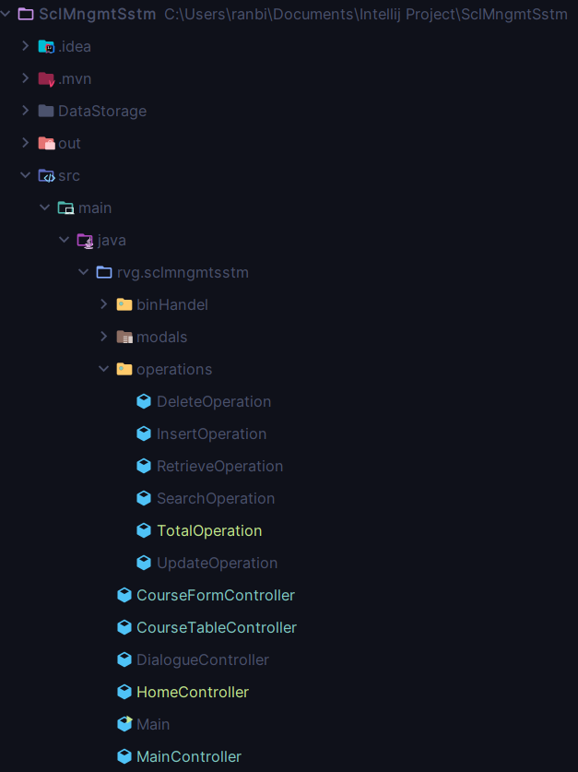
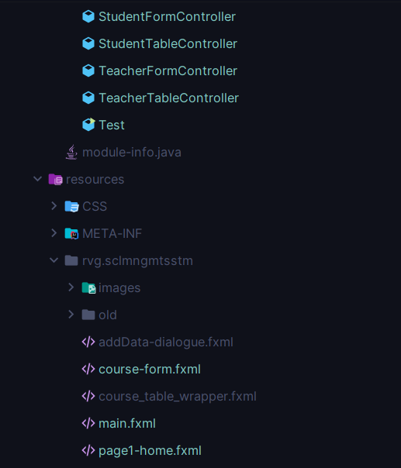
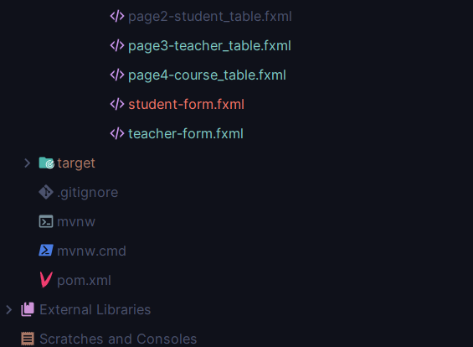
Final Project Hierarchy

Slide 13
Hence, that was how the whole project is made. Please wait for a quick look of the Final Project.

